Slide 1

DEPARTMENT OF COMPUTER SCIENCE

Slide 2
OOP COURSE OUTLINE
Course Title | Fundamentals of Database Management System
Degree Program | BSc. Degree in Computer Science
Course Code | COSC2072
Credits/Contacts | 4/5
Prerequisite | COSC2071
Semester | Semester 2, year 2
Status of Course | Compulsory
Course Objectives and Learning Outcomes | At the end of the course the student will be able to do: Explain the advantages of using database and DBMS

Slide 3
 | Course Objectives and LO----------
 | Differentiate data models and database languages. Understand ANSI-SPARC Architecture and multi user DBMS Architecture. Use Relational Algebra and Relational Calculus concepts. Define data requirement or business unit in an organization. Develop conceptual database design based on users’ requirement using ER model.

Slide 4
 | Course Objectives and LO----------
 | Develop logical database design based on the conceptual data model. Understand how to use DDL and DML in MS SQL Server database.
Course Description | The development of efficient database applications requires understanding of the fundamentals of database management systems techniques for the design of database and principles of database administration.

Slide 5
 | Course Description--------
Course Description | In this course fundamental concept related to database and Database Management System will be covered. The different approaches for data handling and their advantage and disadvantage, the database environment, data models, and multi user DBMS architecture are some of the core concepts to be addressed in the course.

Slide 6
 | Course Description--------
Course Description | Relational data model is the model to be covered in depth therefore the course cover relational algebra and relational calculus, basic concepts and terminologies in relational data model and basic database development steps and tools used in this model. The laboratory session teaches how to write different SQL statements to implement the database.

Slide 7
Course Content
 | UNIT ONE: INTRODUCTION TO DATABASE 1.1 Basic Concepts of Database and DBMS 1.2 Data Management Approach 1.3 Advantages of Database and DBMS 1.4 The Three level ANSI-SPARC Architecture 1.5 Database Languages 1.6 Functions and components of DBMS 1.7 Multi user DBMS Architecture 1.8 Database Development Life Cycle 1.9 Roles of Database Design and Use 1.10 Database Components

Slide 8
Course Content Continued
 | UNIT TWO: RELATIONAL DATA MODEL 2.1 Basic concept and types of Data models 2.2 History of Relational Data model 2.3 Terminologies in Relational Data model 2.4 Integrity constraints in Relational Data model 2.5 Views and their importance
 | UNIT THREE: RELATIONAL ALGEBRA AND CALCULUS 3.1 Relational Algebra 3.2 Relational Calculus UNIT FOUR: CONCEPTUAL DATABASE DESIGN 4.1 Entity Relationship Modeling 4.2 Enhanced Entity – Relationship Modeling 4.3 Conceptual Database Design Methodology

Slide 9
Course Content Continued
 | UNIT FIVE: LOGICAL DATABASE DESIGN 5.1 Concepts of Logical Database Design 5.2 Normalization 5.3 Logical Database Design Methodology
 | UNIT SIX: STRUCTURED QUERY LANGUAGE(SQL) 6.1 Basics of MS-Access (Query By Example) 6.2 Structured Query Language (SQL) 6.3 Introduction to SQL 6.4 Data Definition Language 6.5 Data Manipulation Language

Slide 10
Teaching and Assessment Methods
Teaching and learning Methods | Lecture Discussion and case studies Laboratory, Practical work
Assessment/Evaluation and Grading System | Theoretical Test------------------------------(15%) Assignment----------------------------------- (10%) Project Work----------------------------------(25%) Final Exam------------------------------------(50%)
Text Books | Thomas Connoly, Carolyn Begg; Database Systems: A practical guide to Design, implementation, and management, 6th ed. 2015, Pearson education, Inc., Addison Wesley (USA)

Slide 11
Teaching and Assessment Methods
Reference Materials | Ramez Elmasri, Shamkant B. Navathe, Fundamentals of Database Systems,5th ed., 2009, Pearson Education, Inc. Rod Stephens, Beginning Database Design Solutions, 2009, Wiley Publishing, Inc., Indianapolis, Indiana Database Management System; 2015, Tutorials Point (I) Pvt. Ltd. (tutorialspoint.com) Ramez Elmasri, Shamkant B. Navathe, Fundamentals of Database Systems, 6th ed., 2011, Pearson Education, Inc., publishing as Addison-Wesley; Boston, Massachusetts (Soft Copy) Silberschatz, Abraham, Henry F. Korth and S. Sudarshan. . Database system concepts. 6th ed. McGraw Hill Inc., 2011.

Slide 12
CHAPTER ONE
INTRODUCTION TO DATABASE

Slide 13
1. What is Database
Database is a very large integrated collection of data
It is used to maintain internal records, to present data to customers and clients on the World-Wide-Web, and to support many other commercial processes.
By data, we mean known facts that can be recorded and that have implicit meaning.
For example, consider the names, telephone numbers, and addresses of the people you know.
You may have recorded this data in an indexed address book or you may have stored it on a hard drive, using a personal computer and software such as Microsoft Access or Excel.

Slide 14
1. What is Database-----
This collection of related data with an implicit meaning is a database.
A database has the following implicit properties:
A database represents some aspect of the real world, sometimes called the miniworld or the universe of discourse (UoD).
Changes to the miniworld are reflected in the database.
Database Management System(DBMS)– a powerful tool(software package) for creating and managing large amounts of data efficiently and allowing it to persist over long periods of time, safely.

Slide 15
1. What is Database-----
Data management involves both definition and the manipulation of the data
So the term database refers to a collection of data that is managed by a DBMS.
Thus the DB course is about:
How to organize data ;supporting multiple users; efficient and effective data retrieval ;secured and reliable storage of data; maintaining consistent data

Slide 16
1. What is Database-----
What is a Database?- It is a collection of related facts
Filing Cabinet
Hard disk full of data
Diary
Library
DBMS + Database
=
Database System

Slide 17
2. Database Approaches
Data management passes through the different levels of development. The common are discussed as follows:
Manual Approach
Data storage and retrieval follows the primitive and traditional way of information handling where cards and paper are used for the purpose.
Files for as many event and objects as the organization are used to store information.
Each of the files containing various kinds of information is labelled and stored in one ore more cabinets.

Slide 18
2. Database Approaches--------
The cabinets could be kept in safe places for security purpose based on the sensitivity of the information contained in it.
Insertion and retrieval is done by searching first for the right cabinet then for the right the file then the information.
It requires intensive human labor to organize and access data
Use indexing system to facilitate access to the data.

Slide 19
Example , Personal Calendar
We might start by building a file with the following structure:
What Day Time with_whom Where
Lunch 10/24 1pm Abebe Bole
CS123 10/25 9am Seble Room 234
Shop 10/26 9am Ayele Piassa
Dinner 10/26 6PM Elfinesh Café
This calendar is easy to deal with.

Slide 20
Let us also build phone address book
Abebe A. 0911164743
Seble K. 0912150844
Ayele L. 0913170841
Elfinesh W. 0911169673
Ermias H. 0912151043
Worku A. 0911199904
Worku D. 0912620410
Abebe D. 0914556768

Slide 21
Limitations of the Manual Approach
1. Problem of Data Organization
Suppose we want to cancel one of our appointments.
Two conceptual “entities” -- address and calendar -- with a relationship between them, linking people in the calendar to their contact information.
2. Problem of Efficiency
Size of your personal address book is probably less than one hundred entries, but there are things we'd like to do quickly and efficiently.
“Give me all appointments on 10/28”
“When am I next meeting Dr. Dawit?”

Slide 22
Limitations of the Manual Approach
What would happen if you were using a business calendar with hundreds of thousands of entries?
3. Prone to error
4. Difficult to update, retrieve, integrate
5. You have the data but it is difficult to compile the information
6. Significant amount of duplication of data
7. Cross referencing is difficult

Slide 23
What is the Solutions?
What is the solution to overcome the problems or difficulties inherited in the manual data handling approaches?
Two computerized approaches evolved to overcome this limitations
Traditional File Based Approach → Decentralised
Database Approach→ Centralised

Slide 24
2. Traditional File Based Approach
This approach uses computer for data processing to the business community, via the device for data storage and processing increase.
File based systems were an early attempt to computerize the manual filing system.
This approach is the decentralized computerized data handling method.
Since every application defines and manages its own data, the system is subjected to serious data duplication problem.

Slide 25
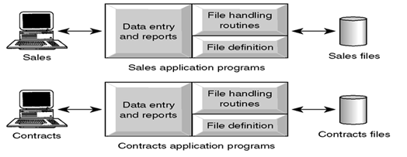
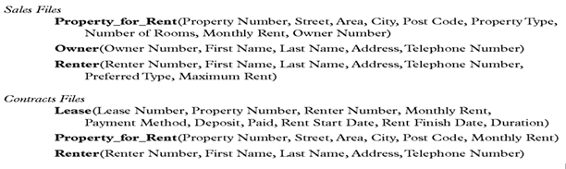

Slide 26
Limitations of Traditional File-Based Approach
1. Data Redundancy (Duplication of data)
Same data is held by different programs
Wasted space (Uncontrolled duplication of data)
2. Separation and isolation of data
Each program maintains its own set of data.
Users of one program may be unaware of potentially useful data held by other programs.
Limited data sharing
Special codes for different queries

Slide 27
Limitations of Traditional File-Based Approach-----
3. Data Inconsistency and confusion. Eg. Consider an organization
Personnel Department stores details relating to each member.
Payroll Department stores salaries of each staff
There are potentially different values and/or different formats for the same item.
Consider the duplication of data between the payroll and personnel departments.
If an employee moves house and the change of address is communicated only to personnel and not to payroll, the person’s pay slip will be sent to the wrong address.

Slide 28
Limitations of Traditional File-Based Approach-----
4. Data Dependence
File structure is defined in the program code and is dependent on the application programming language.
Each application program must have its own processing routines for reading, inserting, updating and deleting data.
5. Incompatible file formats (Lack of Data Sharing and Availability)
Programs are written in different languages, and so cannot easily access each others files.
Eg.
personnel writes in C
payroll writes in COBOL

Slide 29
Limitations of Traditional File-Based Approach-----
Suppose payroll wants to know when a certain employee will be on pension.
It is difficult to share this information unless we have another application programmer to write software to convert the files to some common format.
6. Poor Security and Administration
Unauthorized people may access the data.
7. Data Anomalies
A. Modification Anomalies:
A problem experienced when one or more data value is modified on one application program but not one others containing the same data set.

Slide 30
Limitations of Traditional File-Based Approach-----
B. Deletion Anomalies:
A problem encountered where one record set is deleted from one application but remain untouched in other application programs.
C. Insertion Anomalies:
A problem experienced whenever there is a new data item to be recorded, and the recording is not made in all the applications.

Slide 31
3. Database Approach
The limitation of the file based can be attributed to two factors:
Definition of data is embedded in the application programs, rather than being stored separately and independently.
There is no control over the access and manipulation of data beyond that imposed by the application programs.
To become more effective, a new approach was required by the name Database Approach.
What emerged were the database and database management systems.
A single repository of data is maintained

Slide 32
3. Database Approach-----
The database systems is presented for user with a view of data organized as tables called relations
It emphasizes the integration and sharing of data throughout the organization.
Database is a collection of logically related data where these logically related data comprises
entities, attributes, relationships, and business rules of an organization's information.
Database is deigned once and used simultaneously by many users.

Slide 33
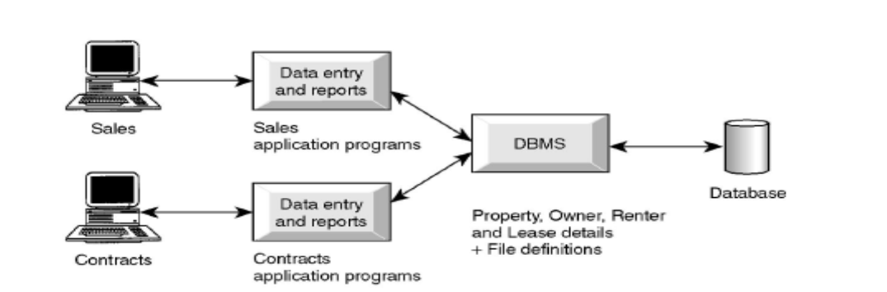
3. Database Approach------
Unlike the traditional file based approach ,in database there is the separation of the data definition from the application.
Thus the application is not affected by changes made in the data structure and file organization.

Slide 34
3. Database Approach-----
A Database is a shared collection of logically related data designed to meet the information needs of an organization- (Centralized System).
System Catalog (Data Dictionary or Metadata) provides the description of the data to enable program–data independence.
The database contains not only the database itself but also a complete definition or description of the database.
This definition is stored in the system catalog, which contains information such as the structure of each file, type and storage format of each data item and various constraints on the data..
The information stored is called metadata and it describes the structure of the primary database.

Slide 35
Benefits of the Database Approach
Data can be shared:
Two or more users can access and use same data instead of storing data in redundant manner for each user.
2. Improved accessibility of data:
By using structured query languages, the users can easily access data without programming experience.
3. Quality data can be maintained:
The different integrity constraints in the database approach will maintain the quality leading to better decision making

Slide 36
Benefits of the Database Approach------
4. Integrity can be maintained:
Data at different applications will be integrated together with additional constraints to facilitate validity and consistency of shared data resource.
5. Security measures can be enforced:
The shared data can be secured by having different levels of clearance
6. Speed: data storage and retrieval is fast
7. Centralized information control:
Since relevant data in the organization will be stored at one repository, it can be controlled and managed at the central level.

Slide 37
Benefits of the Database Approach------
8. Redundancy can be reduced:
Isolated data is integrated in database to decrease the redundant data stored at different applications
9. Inconsistency can be avoided:
Controlled data redundancy will avoid inconsistency of the data in the database to some extent.
10. Data Independence
Applications insulated from how data is structured and stored

Slide 38
Benefits of the Database Approach------
11. Standards can be enforced:
The different ways of using and dealing with data by different units of the organization can be balanced and standardized by using database approach.
12. Less Labor:
Unlike the other data handling methods, data maintenance will not demand much resource

Slide 39
Limitations and Risk of Database Approach------
Complexity in designing and managing data
The cost and risk during conversion from the old to the new system
High cost to be incurred to develop and administer the system
Complex backup and recovery services from the users perspective
Reduced performance due to centralization and data independency
High impact on the system when failure occurs to the central system.

Slide 40
DBMS Functions
A DBMS performs several important functions that guarantee the integrity and consistency of the data in the database.
Most of those functions are transparent to end users, and most can be achieved only through the use of a DBMS. They include:
Data Dictionary Management
Data Storage Management
Data Transformation and Presentation
Security Management
Multiuser Access Control
Backup and Recovery Management , Data Integrity Management
Database Access Languages and Application Programming Interfaces
Database Communication Interfaces

Slide 41
DBMS Functions-----
Data Dictionary Management
DBMS stores definitions of the data elements and their relationships (metadata) in a data dictionary.
In turn, all programs that access the data in the database work through the DBMS.
The DBMS uses the data dictionary to look up the required data component structures and relationships.
Additionally, any changes made in a database structure are automatically recorded in the data dictionary.
In other words, the DBMS provides data abstraction, and it removes structural and data dependence from the system.

Slide 42
DBMS Functions-----
A useful data dictionary system should store and manage the following types of information:
Descriptions of the schemas of the database system.
Detailed information on physical database design, such as storage structures, access paths, and file and record sizes.
Descriptions of the types of database users, their responsibilities, and their access rights.
Descriptions of the database transactions and applications and relationships of users to transactions.
The relationship between database transactions and the data items referenced by them.

Slide 43
DBMS Functions-----
Usage statistics such as frequencies of queries and transactions and access counts to different portions of the database.
2. Data Storage Management
The DBMS creates and manages the complex structures required for data storage.
A modern DBMS provides storage not only for the data, but also for related data entry forms or screen definitions, report definitions, data validation rules, procedural code, structures to handle video and picture formats, and so on.
Data storage management is also important for database performance tuning.

Slide 44
2. Data Storage Management ----
Performance tuning relates to the activities that make the database perform more efficiently in terms of storage and access speed.
Although the user sees the unit, the DBMS actually stores the database as a single data storage in multiple physical data files.
See the following figure. Such data files may even be stored on different storage media.
Therefore, the DBMS doesn’t have to wait for one disk request to finish before the next one starts.
In other words, the DBMS can fulfill database requests concurrently.

Slide 45
DBMS Functions-----
3. Multi Access Control
To provide data integrity and data consistency, the DBMS uses sophisticated algorithms to ensure that multiple users can access the database concurrently without compromising the integrity of the database.
4. Backup and Recovery Management
The DBMS provides backup and data recovery to ensure data safety and integrity.
Current DBMS systems provide special utilities that allow the DBA to perform routine and special backup and restore procedures.
Recovery Management deals with the recovery of the database after a failure, such as a bad sector in the disk or a power failure.
Such capability is critical to preserving the database’s integrity.

Slide 46
DBMS Functions-----
5. Data Integrity Management
The DBMS promotes and enforces integrity rules, thus minimizing data redundancy and maximizing data consistency.
The data relationships stored in the data dictionary are used to enforce data integrity.
Ensuring data integrity is especially important in transaction-oriented database systems.
6. Database Access Languages and API
The DBMS provides data access through a query language.
A query language is a nonprocedural language—one that lets the user specify what must be done without having to specify how it is to be done.
Structured Query Language (SQL) is the de facto query language and data access standard supported by the majority of DBMS vendors.
The DBMS also provides application programming interfaces to procedural languages such as COBOL, C, Java, Visual Basic.NET, and C#.
The DBMS also provides administrative utilities used by the DBA and the database designer to create, implement, monitor, and maintain the database.

Slide 47
DBMS Functions-----
7. Data Communication Interface
Current-generation DBMSs accept end-user requests via multiple, different network environments.
For example, the DBMS might provide access to the database via the Internet through the use of Web browsers.
In this environment, communications can be accomplished in several ways:
End users can generate answers to queries by filling in screen forms through their preferred Web browser.
The DBMS can automatically publish predefined reports on a Website.
The DBMS can connect to third-party systems to distribute information via e-mail or other productivity applications.

Slide 48
Database Languages
DBMS should have facilities to define the database, manipulate the content of the database and control the database.
It provides the following facilities:
1. Data Definition Language (DDL):
Language used to define each data element required by the organization.
Commands for setting up schema or database
These commands are used to setup a database, create, delete and alter table with the facility of handling constraints
2. Data Manipulation Language (DML):
Is a core command used by end-users and programmers to store, retrieve, and access the data in the database e.g. SQL
Since the required data or Query by the user will be extracted using this type of language, it is also called "Query Language"

Slide 49
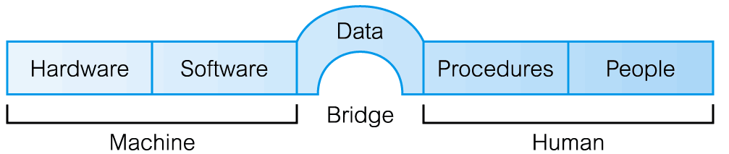
Database System Environment
The term database system refers to an organization of components that define and regulate the collection, storage management, and use of data within a database environment.
From a general management point of view, the database system is composed of the five major parts: hardware, software, people, procedures, and data.

Slide 50
Database System Environment------
Taking a DBMS as a system, To design and use a database, there will be the interaction or integration of Hardware, Software, Data, Procedure and People.
Hardware:
These components are comprised of various types of personal computers, mainframe or any server computers to be used in multi-user system, network infrastructure, and other peripherals required in the system.
2. Software:
are collection of commands and programs used to manipulate the hardware to perform a function.

Slide 51
Database System Environment------
Like the DBMS software, application programs, operating systems, network software, language software and other relevant software.
3. Procedure:
This is the rules and regulations on how to design and use a database.
It includes procedures like how to log on to the DBMS, how to use facilities, how to start and stop transaction, how to make backup, how to treat hardware and software failure…

Slide 52
Database System Environment------
4. Data:
Data is the most important component to the user of the database.
There are two categories of data in any database system: that is Operational and Metadata.
Operational data is the data actually stored in the system to be used by the user.
Metadata is the data that is used to store information about the database itself.

Slide 53
Database System Environment------
The structure of the data in the database is called the schema, which is composed of the Entities, Properties of entities, and relationship between entities and business constraints.
5. People:
This component is composed of the people in the organization that are responsible or play a role in designing, implementing, managing, administering and using the resources in the database.
This component includes group of people who are experts or user of DB

Slide 54
3. Database Development Life Cycle (DDLC)
1. Planning:
It is identifying information gap in an organization and propose a database solution to solve the problem.
2. Analysis:
It concentrates more on fact finding about the problem or the opportunity.
Feasibility analysis, requirement determination and structuring, and selection of best design method are also performed at this phase.
3. Design:
The phase is further divided into three sub-phases.

Slide 55
3. Database Development Life Cycle (DDLC)
Conceptual Design:
Concise description of the data, relationship between data and constraints on the data.
There is no implementation or physical detail consideration.
Used to elicit and structure all information requirements
B. Logical Design:
It is a higher level conceptual abstraction with selected specific data model to implement the data structure.
It is particular DBMS independent and with no other physical considerations.

Slide 56
3. Database Development Life Cycle (DDLC)
C. Physical Design:
Physical implementation of the logical design of the database with respect to internal storage and file structure of the database for the selected DBMS.
To develop all technology and organizational specification.
4. Implementation:
The testing and deployment of the designed database for use.
5. Operation and Support:
Administering and maintaining the operation of the database system and providing support to users.

Slide 57
5. Roles in Database Design and Use
There are group of roles played by different stakeholders of the designing and operation of a database system. These are:
Database Administrator (DBA)
Responsible to oversee, control and manage the database resources
Authorizing access to the database
Coordinating and monitoring the use of the database
Responsible for determining and acquiring hardware and software resources
Accountable for problems like poor security, poor performance of the system

Slide 58
5. Roles in Database Design and Use------
Involves in all steps of database development
2. Database Designer (DBD)
Identifies the data to be stored and choose the appropriate structures to represent and store the data.
Should understand the user requirement and should choose how the user views the database.
Involve on the design phase before the implementation of the database system.
3. Application Programmer and Systems Analyst
System analyst determines the user requirement and how the user wants to view the database.

Slide 59
5. Roles in Database Design and Use------
The application programmer implements these specifications as programs; code, test, debug, document and maintain the application program.
The application programmer determines the interface on how to retrieve, insert, update and delete data in the database.
The application could use any high level programming language according to the availability, the facility and the required service.
4. End Users
Workers, whose job requires accessing the database frequently for various purposes, there are different group of users in this category. Like Naïve Users and Sophisticated Users

Slide 60
Example of a Database
Part of a UNIVERSITY environment. Information concerning students, courses, and grades in a university environment
Some mini-world entities:
STUDENTs
COURSEs
SECTIONs (of COURSEs)
DEPARTMENTs
INSTRUCTORs
.
Some mini-world relationships:
SECTIONs are of specific COURSEs
STUDENTs take SECTIONs
COURSEs have prerequisite COURSEs
INSTRUCTORs teach SECTIONs
COURSEs are offered by DEPARTMENTs
STUDENTs major in DEPARTMENTs

Slide 61
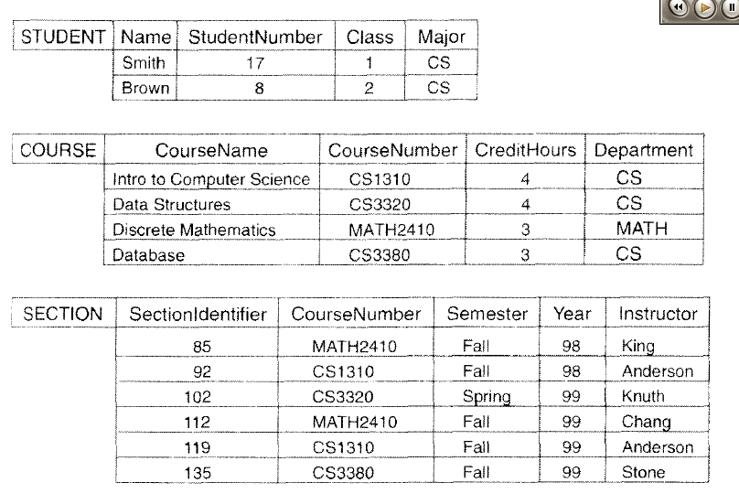

Slide 62
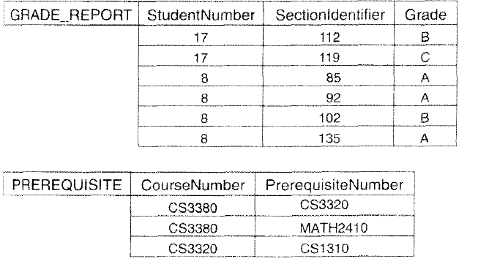

Slide 63
An Example (cont'd.)
Construct UNIVERSITY database
Store data to represent each student, course, section, grade report, and prerequisite as a record in appropriate file
Relationships among the records
Manipulation involves querying and updating
Examples of queries:
Retrieve the transcript
List the names of students who took the section of the ‘Database’ course offered in fall 2013 and their grades in that section
List the prerequisites of the ‘Fundaments of Database’ course
Examples of updates:
Change the class of ‘Lemma’ to sophomore
Create a new section for the ‘Database’ course for this semester
Enter a grade of ‘A’ for ‘Lemma’ in the ‘Database’ section of last semester

Slide 64
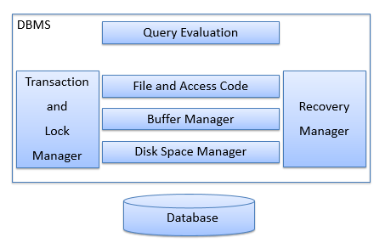
Typical DBMS Structure/Database System

Slide 65
DBMS Components(Structure)
Disk space (storage) manager
responsible for interaction with the OS file system
Allows other levels of the DBMS to consider the data as a collection of pages
2. Buffer manager
responsible for bringing pages into main memory from disk
Including the management of a replacement policy when main memory is full
3. File and access code
allows the query evaluation system to request data from lower levels

Slide 66
DBMS Components(Structure)------
4. Query evaluation
most modern DBMSs will optimize queries
There are often multiple equivalent queries
The query optimizer determines an efficient execution plan for a query
5. Transaction lock manager
responsible for allowing concurrent access
While maintaining data integrity
6. Recovery manager
responsible for maintaining a log and restoring the system after a crash

Slide 67
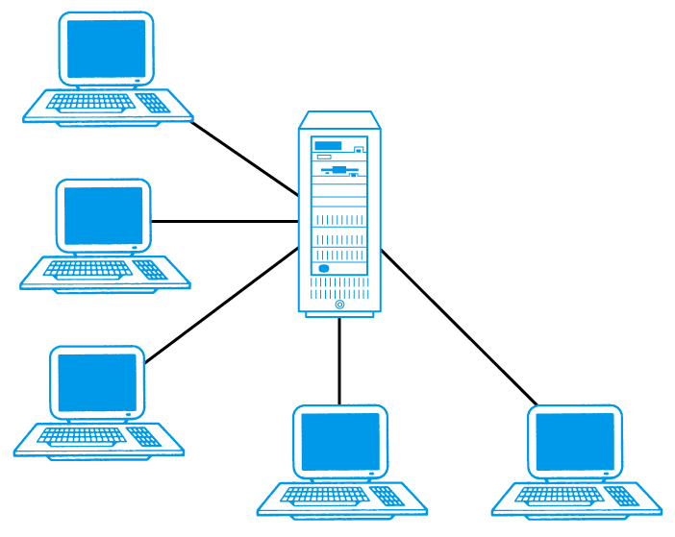
DBMS Architectures
The common Architecture to implement multi user database Management system.
Teleprocessing
File – Server
Client – Server
1. Teleprocessing
Traditional architecture.
Single mainframe with a number of terminals attached.
Trend is now towards downsizing.

Slide 68
2. File-Server
File-server is connected to several workstations across a network.
Database resides on file-server.
DBMS and applications run on each workstation.
Disadvantages include:
Significant network traffic.
Copy of DBMS on each workstation.
Concurrency, recovery and integrity control more complex.

Slide 69
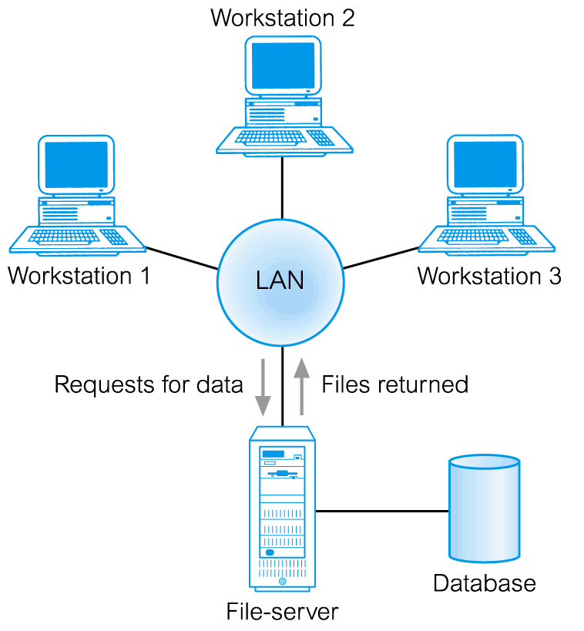
File-Server Architecture

Slide 70
File-Server Architecture
Client (tier 1) manages user interface and runs applications.
Server (tier 2) holds database and DBMS.
Advantages include:
wider access to existing databases;
increased performance;
possible reduction in hardware costs;
reduction in communication costs;
increased consistency.

Slide 71
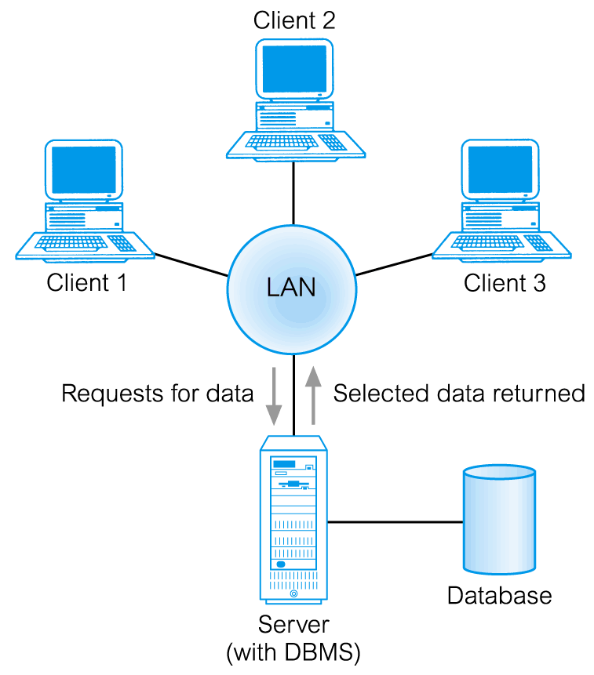
3. 1 Traditional Two-Tier Client-Server

Slide 72
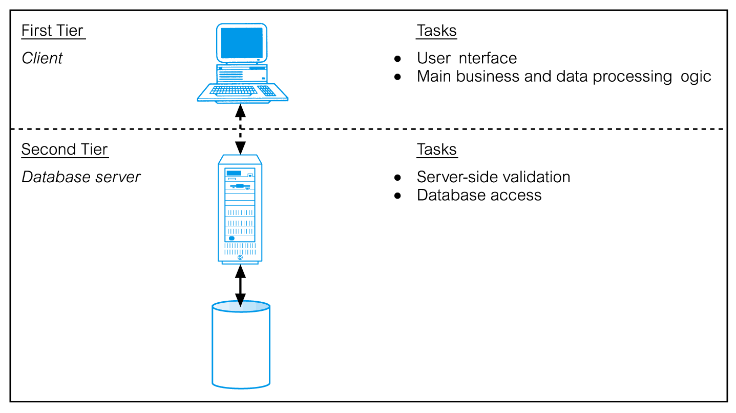
Traditional Two-Tier Client-Server

Slide 73
3.2 Three-Tier Client-Server
Client side presented two problems preventing true scalability:
‘Fat’ client, requiring considerable resources on client’s computer to run effectively.
Significant client side administration overhead.
By 1995, three layers proposed, each potentially running on a different platform.
Advantages:
‘Thin’ client, requiring less expensive hardware.
Application maintenance centralized.
Easier to modify or replace one tier without affecting others.
Separating business logic from database functions makes it easier to implement load balancing.
Maps quite naturally to Web environment.

Slide 74
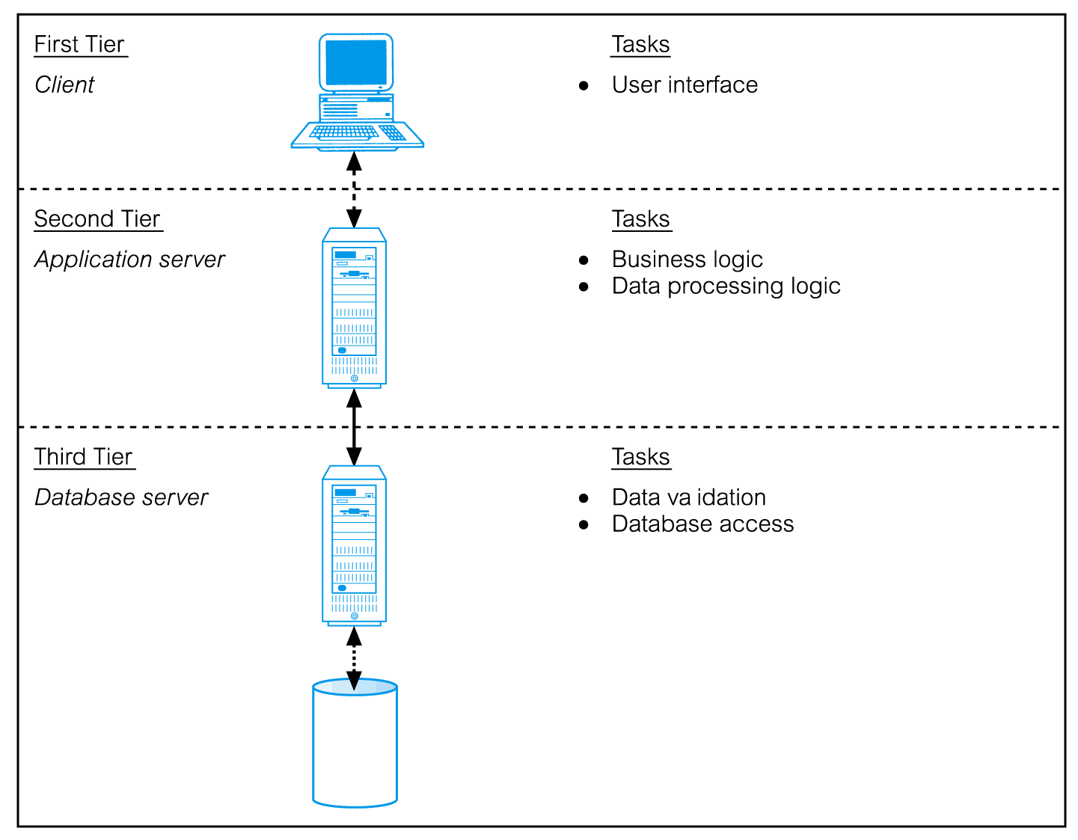
Three-Tier Client-Server

